Slide 1
Chapter 9
Database Planning, Design,
and Administration
Transparencies
Notes:
September 98
1
Chapter Name

Slide 2
Chapter 9 - Objectives
Main components of an information system.
Main stages of database application lifecycle.
Main phases of database design: conceptual, logical, and physical design.
Benefits of CASE tools.
How to evaluate and select a DBMS.
Distinction between data administration and database administration.
Purpose and tasks associated with data administration and database administration.
2
Notes:
September 98
2
Chapter Name

Slide 3
Software Depression
Last few decades have seen proliferation of software applications, many requiring constant maintenance involving:
  correcting faults,
  implementing new user requirements,
  modifying software to run on new or upgraded platforms.
Effort spent on maintenance began to absorb resources at an alarming rate.

Slide 4
Software Depression
As a result, many major software projects were
  late,
  over budget,
  unreliable,
  difficult to maintain,
  performed poorly.
In late 1960s, led to ‘software crisis’, now refer to as the ‘software depression’.

Slide 5
Software Depression
Major reasons for failure of software projects includes:
- lack of a complete requirements specification;
- lack of appropriate development methodology;
- poor decomposition of design into manageable components.
Structured approach to development was proposed called information systems lifecycle.

Slide 6
Information System
Resources that enable collection, management, control, and dissemination of information throughout an organization.
Database is fundamental component of I.S., and its development/usage should be viewed from perspective of the wider requirements of the organization.

Slide 7
Database Application Lifecycle
Database planning
System definition
Requirements collection and analysis
Database design
DBMS selection (optional)

Slide 8
Database Application Lifecycle
Application design
Prototyping (optional)
Implementation
Data conversion and loading
Testing
Operational maintenance.

Slide 9
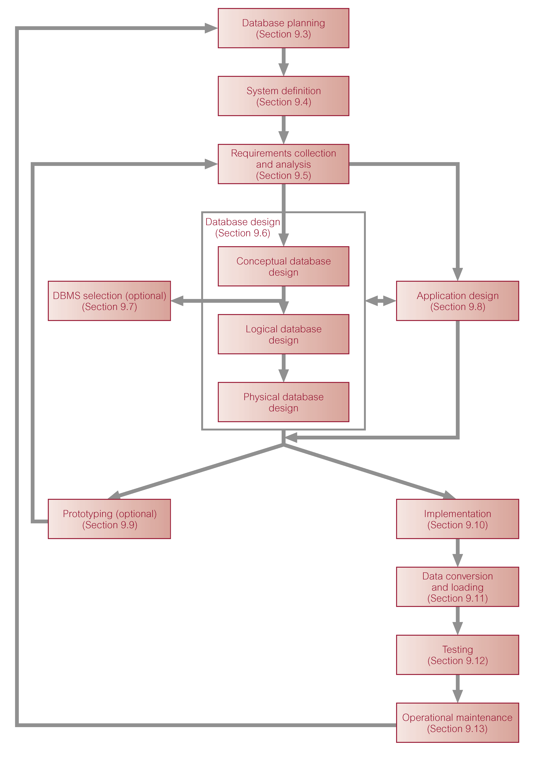
Stages of the Database Application Lifecycle

Slide 10
Database Planning
Management activities that allow stages of database application lifecycle to be realized as efficiently and effectively as possible.
Must be integrated with overall IS strategy of the organization.

Slide 11
Database Planning – Mission Statement
Mission statement for the database project defines major aims of database application.
Those driving database project normally define the mission statement.
Mission statement helps clarify purpose of the database project and provides clearer path towards the efficient and effective creation of required database application.

Slide 12
Database Planning – Mission Objectives
Once mission statement is defined, mission objectives are defined.
Each objective should identify a particular task that the database must support.
May be accompanied by some additional information that specifies the work to be done, the resources with which to do it, and the money to pay for it all.

Slide 13
Database Planning
Database planning should also include development of standards that govern:
  how data will be collected,
  how the format should be specified,
  what necessary documentation will be needed,
  how design and implementation should proceed.

Slide 14
System Definition
Describes scope and boundaries of database application and the major user views.
User view defines what is required of a database application from perspective of:
  a particular job role (such as Manager or Supervisor) or
  enterprise application area (such as marketing, personnel, or stock control).

Slide 15
System Definition
Database application may have one or more user views.
Identifying user views helps ensure that no major users of the database are forgotten when developing requirements for new application.
User views also help in development of complex database application allowing requirements to be broken down into manageable pieces.

Slide 16
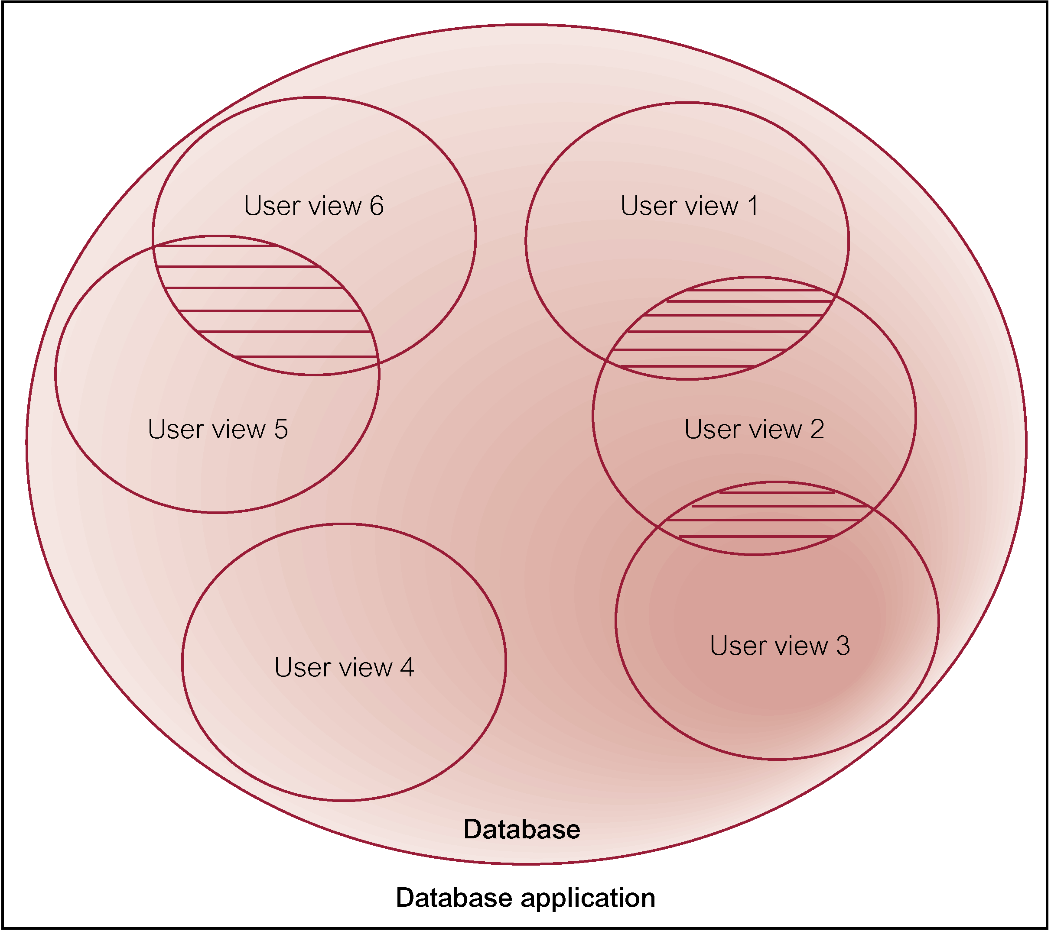
Representation of a Database Application with Multiple User Views

Slide 17
Requirements Collection and Analysis
Process of collecting and analyzing information about the part of organization to be supported by the database application, and using this information to identify users’ requirements of new system.

Slide 18
Requirements Collection and Analysis
Information is gathered for each major user view including:
  a description of data used or generated;
  details of how data is to be used/generated;
  any additional requirements for new database application.
Information is analyzed to identify requirements to be included in new database application.

Slide 19
Requirements Collection and Analysis
Another important activity is deciding how to manage database application with multiple user views.
Three main approaches:
  centralized approach;
  view integration approach;
  combination of both approaches.

Slide 20
Requirements Collection and Analysis
Centralized approach
  Requirements for each user view are merged into a single set of requirements.
  A global data model is created based on the merged requirements (which represents all user views).

Slide 21
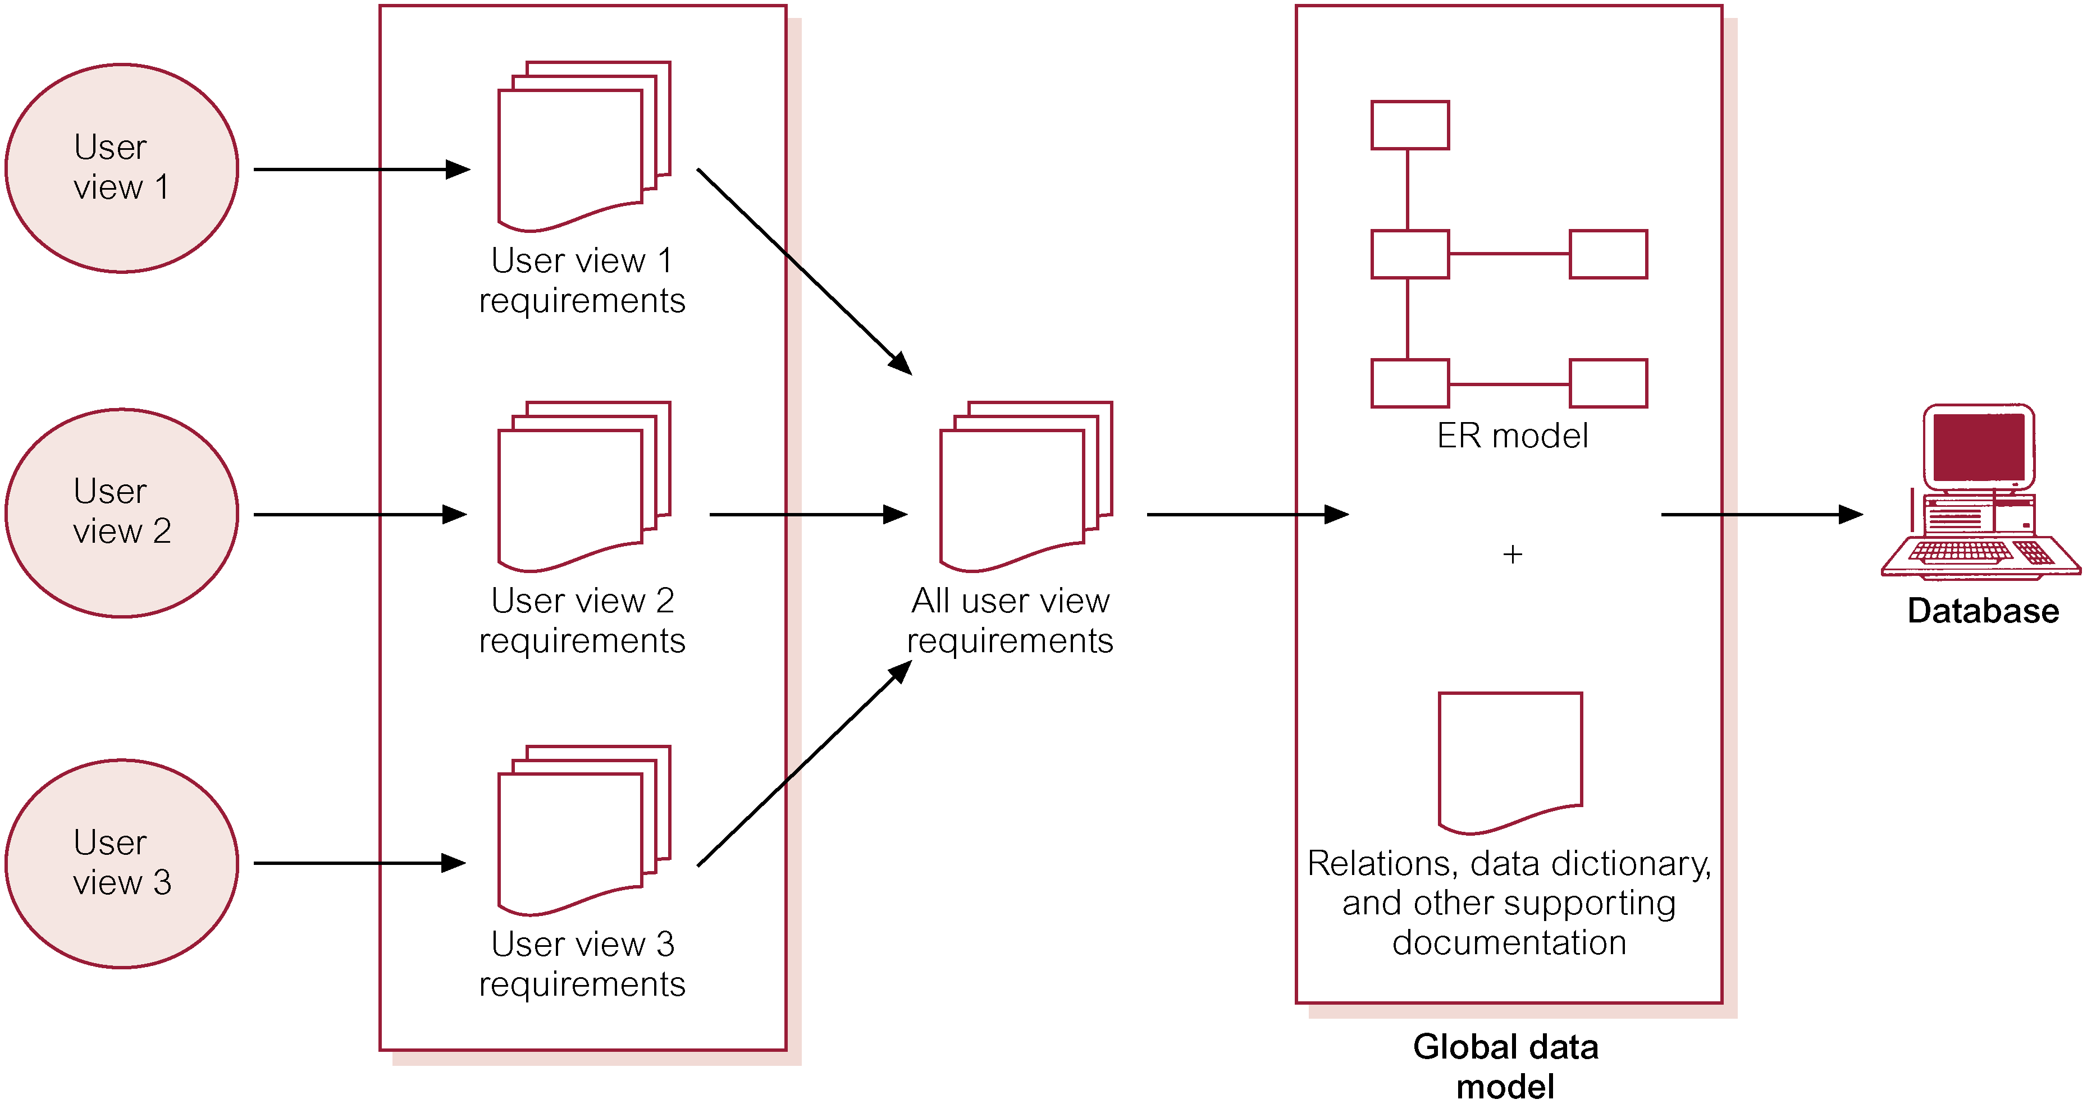
Centralized Approach to Managing Multiple User Views

Slide 22
Requirements Collection and Analysis
View integration approach
  Requirements for each user view are used to build a separate data model.

Slide 23
Requirements Collection and Analysis
Data model representing single user view is called a local data model, composed of diagrams and documentation describing requirements of a particular user view of database.
Local data models are then merged to produce a global data model, which represents all user views for the database.

Slide 24
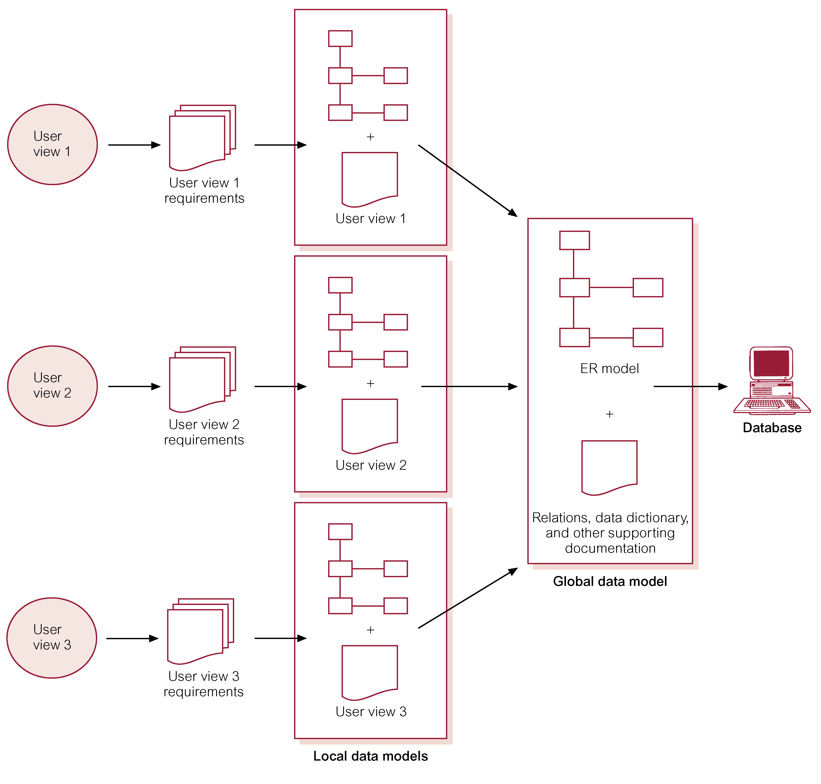
View Integration Approach to Managing Multiple User Views

Slide 25
Database Design
Process of creating a design for a database that will support the enterprise’s operations and objectives.

Slide 26
Database Design
Major aims:
  Represent data and relationships between data required by all major application areas and user groups.
  Provide data model that supports any transactions required on the data.
  Specify a minimal design that is appropriately structured to achieve stated performance requirements for the system (such as response times).

Slide 27
Database Design
Approaches include:
  Top-down
  Bottom-up
  Inside-out
  Mixed

Slide 28
Database Design
Main purposes of data modeling include:
  to assist in understanding the meaning (semantics) of the data;
  to facilitate communication about the information requirements.
Building data model requires answering questions about entities, relationships, and attributes.

Slide 29
Database Design
A data model ensures we understand:
  - each user’s perspective of the data;
  - nature of the data itself, independent of its physical representations;
  - use of data across user views.

Slide 30
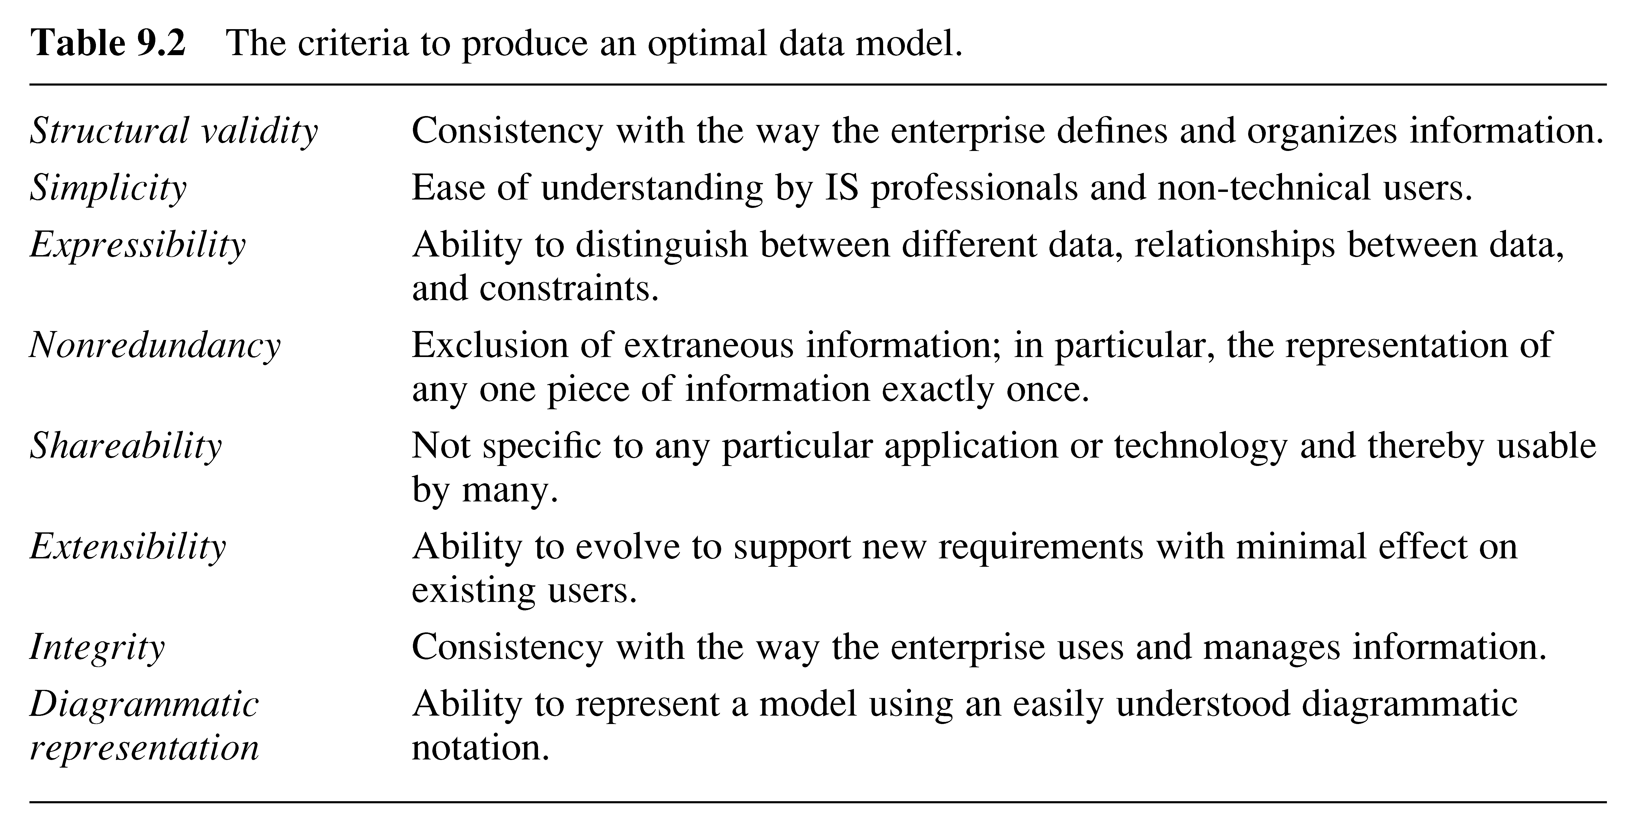
Criteria to Produce an Optimal Data Model

Slide 31
Database Design
Three phases of database design:
  Conceptual database design
  Logical database design
  Physical database design.

Slide 32
Conceptual Database Design
Process of constructing a model of the information used in an enterprise, independent of all physical considerations.
Data model is built using the information in users’ requirements specification.
Source of information for logical design phase.

Slide 33
Logical Database Design
Process of constructing a model of the information used in an enterprise based on a specific data model (e.g. relational), but independent of a particular DBMS and other physical considerations.
Conceptual data model is refined and mapped on to a logical data model.

Slide 34
Physical Database Design
Process of producing a description of the database implementation on secondary storage.
Describes storage structures and access methods used to achieve efficient access to data.
Tailored to a specific DBMS system.

Slide 35
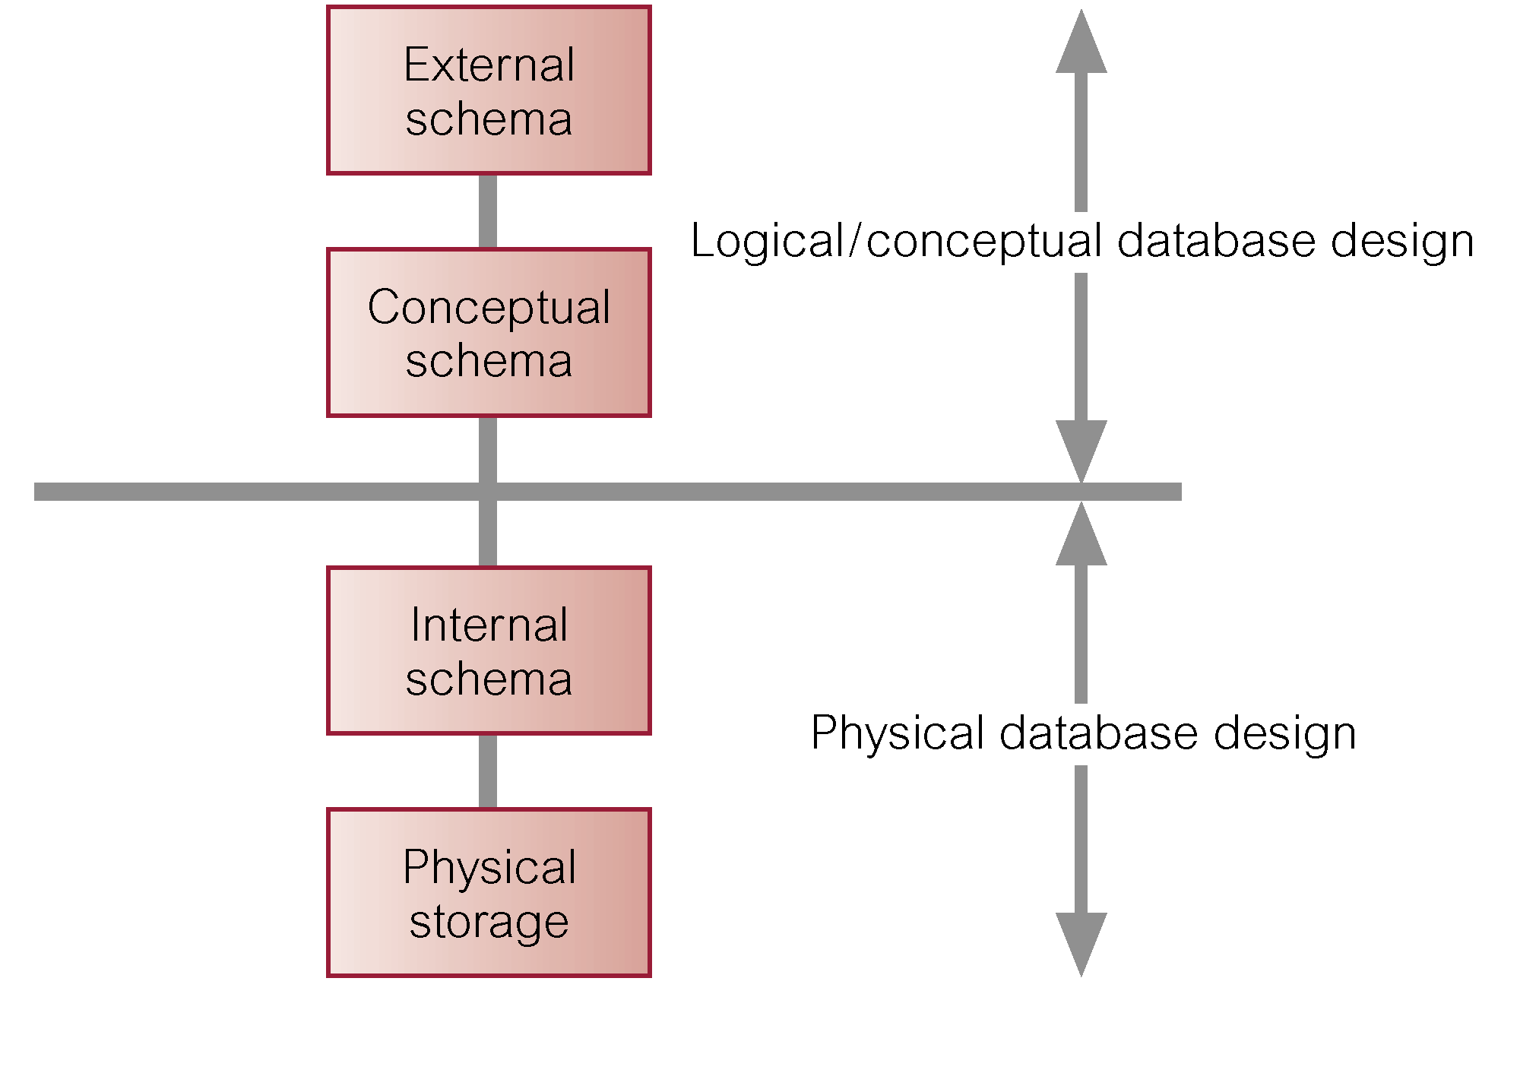
Three-Level ANSI-SPARC Architecture and Phases of Database Design

Slide 36
DBMS Selection
Selection of an appropriate DBMS to support the database application.
Undertaken at any time prior to logical design provided sufficient information is available regarding system requirements.
Main steps to selecting a DBMS:
  define Terms of Reference of study;
  shortlist two or three products;
  evaluate products;
  recommend selection and produce report.

Slide 37
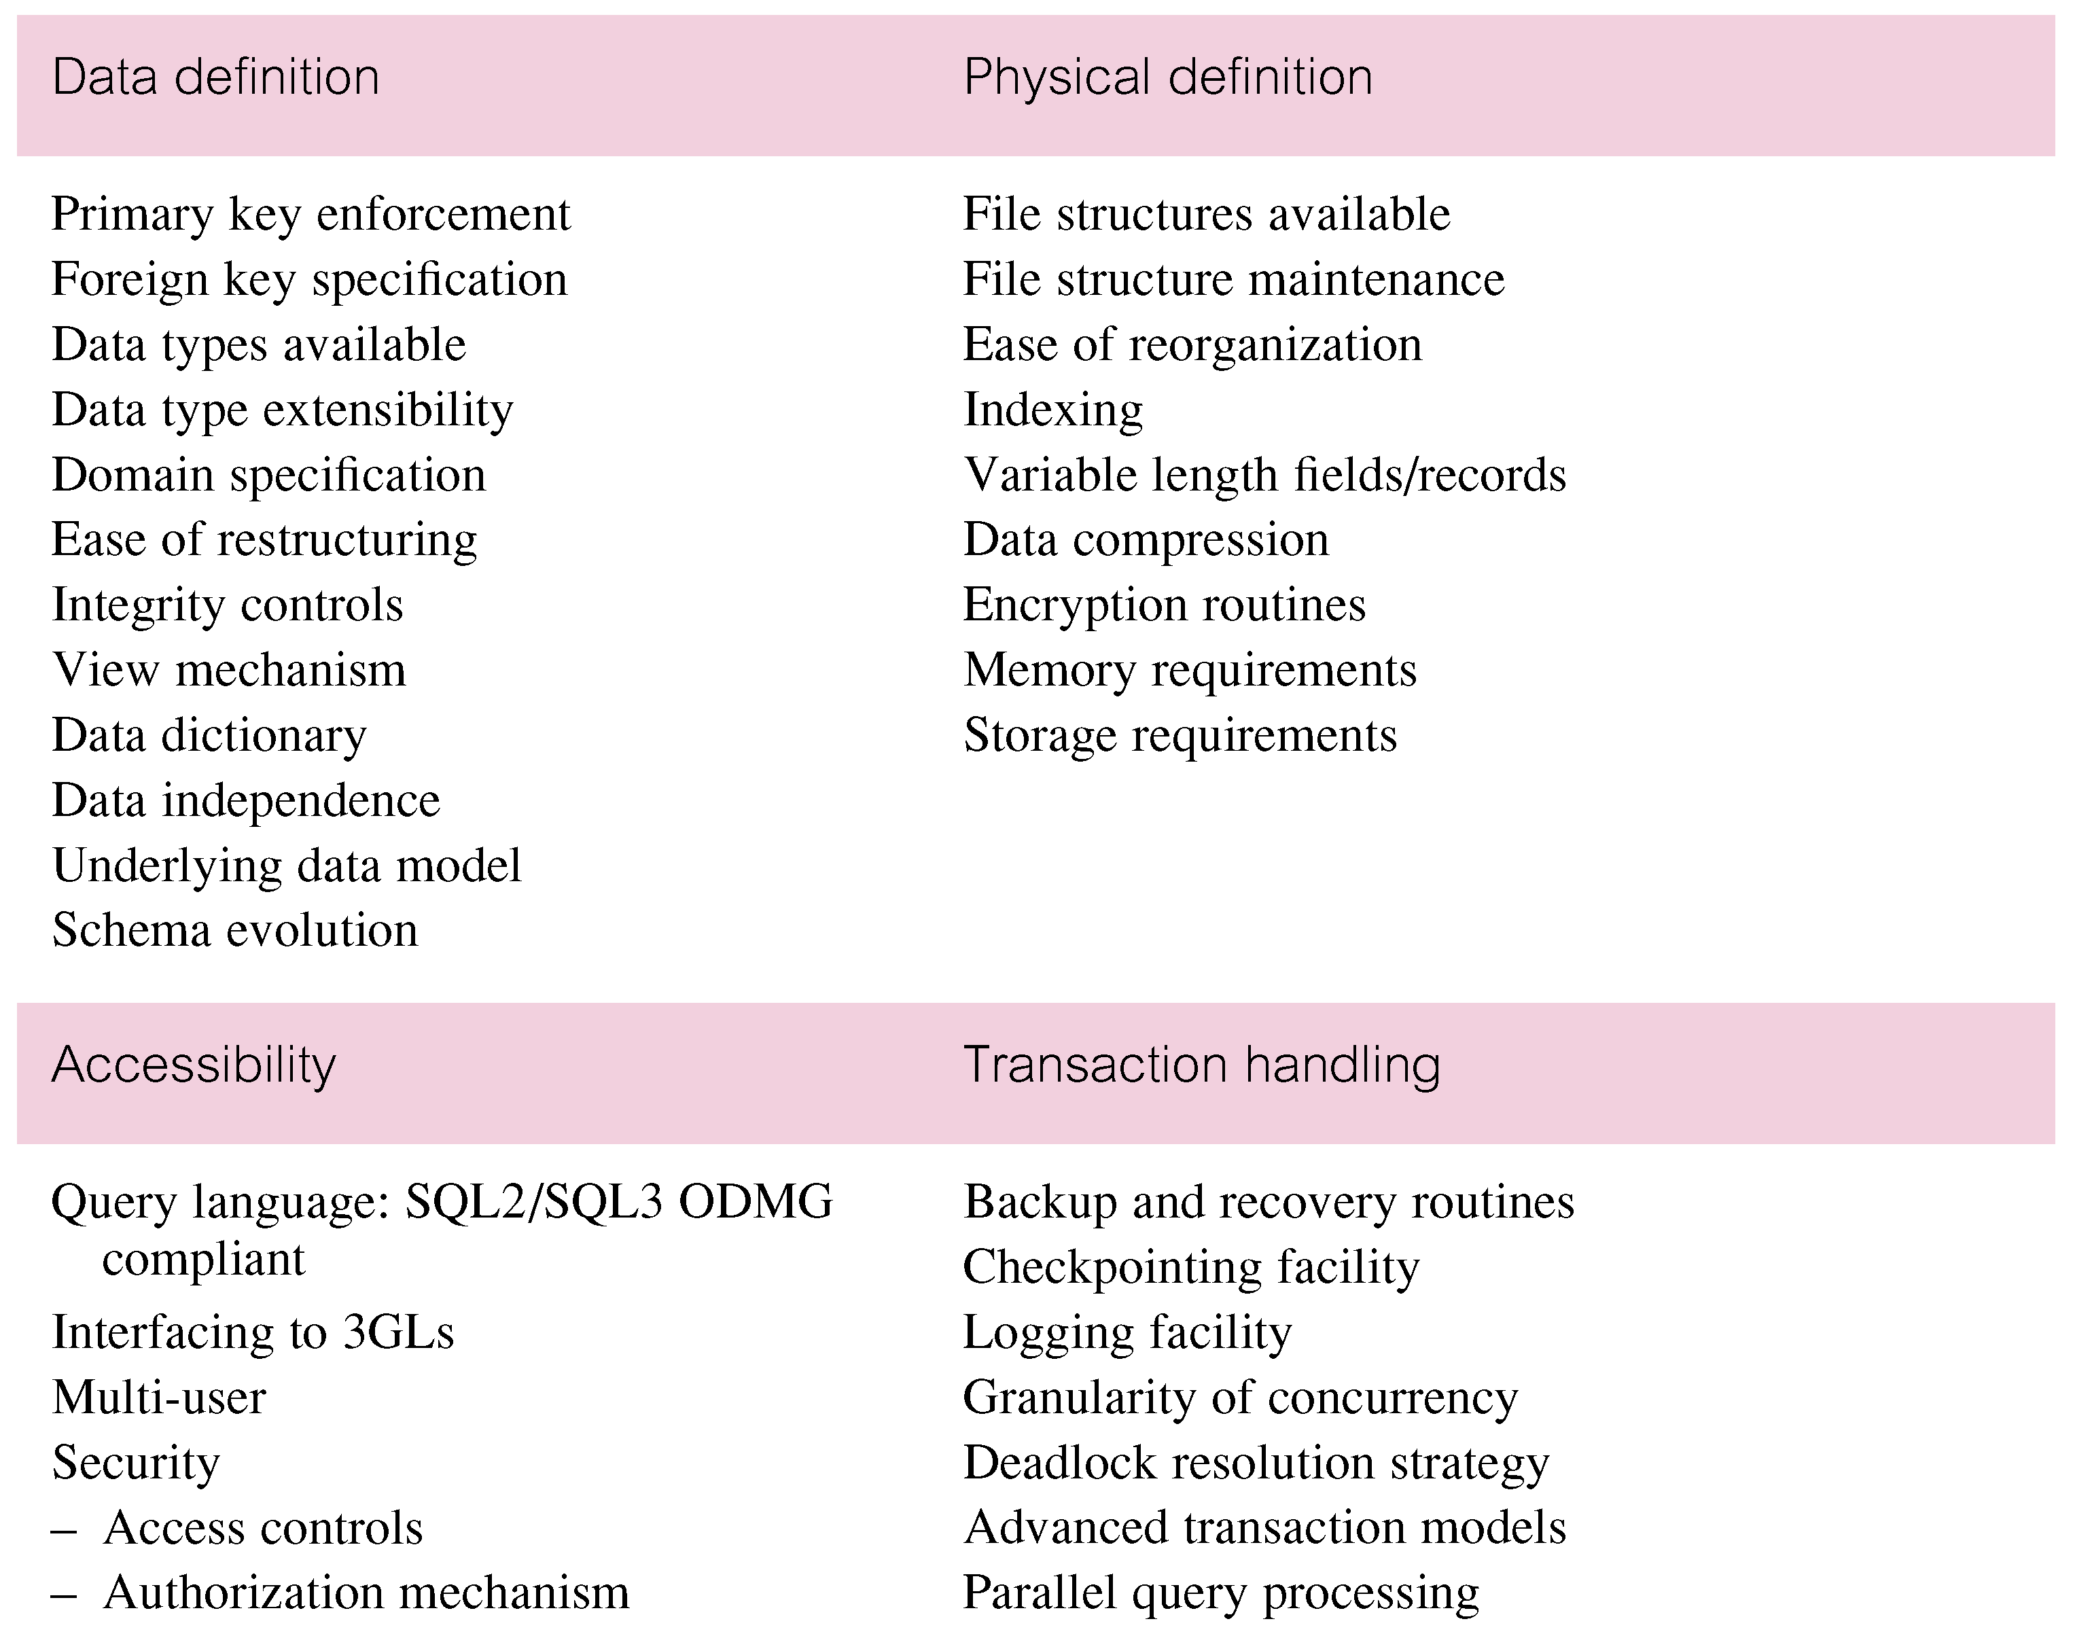
DBMS Evaluation Features

Slide 38
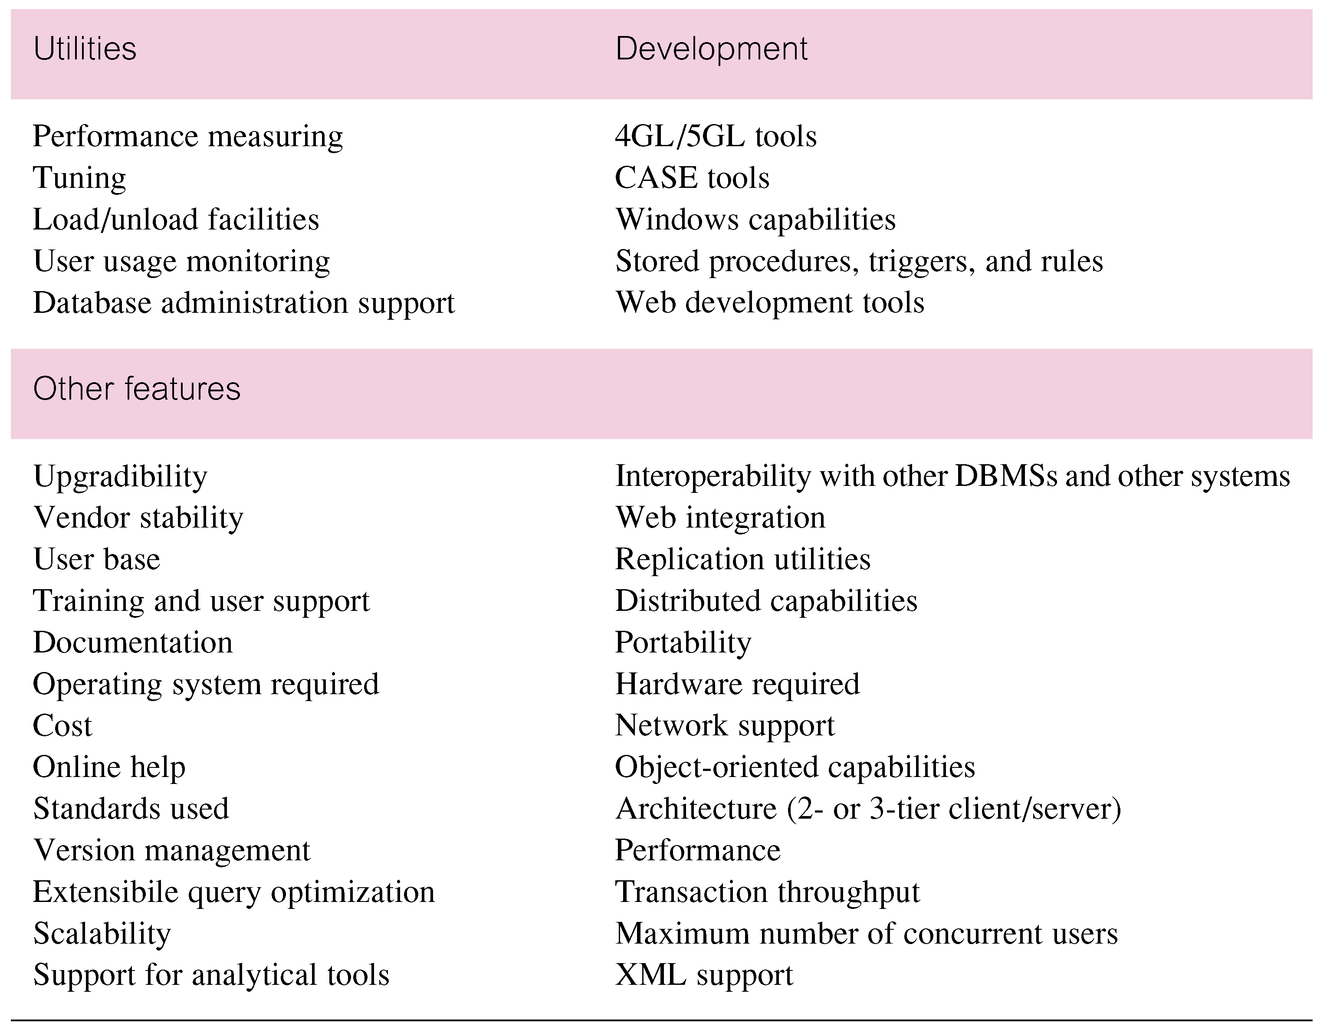
DBMS Evaluation Features

Slide 39
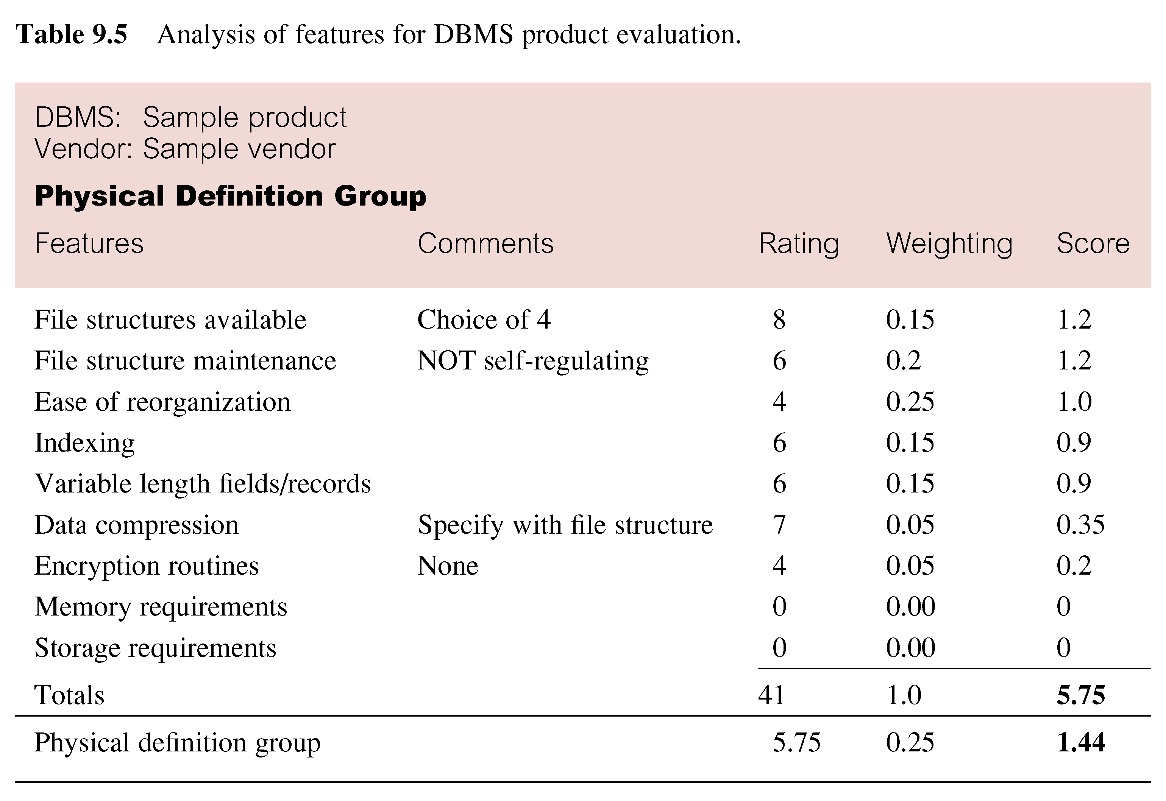
Example - Evaluation of DBMS Product

Slide 40
Application Design
Design of user interface and application programs that use and process the database.
Database and application design are parallel activities.
Includes two important activities:
  transaction design;
  user interface design.

Slide 41
Application Design - Transactions
An action, or series of actions, carried out by a single user or application program, which accesses or changes content of the database.
Should define and document the high-level characteristics of the transactions required.

Slide 42
Application Design - Transactions
Important characteristics of transactions:
  data to be used by the transaction;
  functional characteristics of the transaction;
  output of the transaction;
  importance to the users;
  expected rate of usage.
Three main types of transactions: retrieval, update, and mixed.

Slide 43
Prototyping
Building working model of a database application.
Purpose
  to identify features of a system that work well, or are inadequate;
  to suggest improvements or even new features;
  to clarify the users’ requirements;
  to evaluate feasibility of a particular system design.

Slide 44
Implementation
Physical realization of the database and application designs.
  Use DDL to create database schemas and empty database files.
  Use DDL to create any specified user views.
  Use 3GL or 4GL to create the application programs. This will include the database transactions implemented using the DML, possibly embedded in a host programming language.

Slide 45
Data Conversion and Loading
Transferring any existing data into new database and converting any existing applications to run on new database.
Only required when new database system is replacing an old system.
  DBMS normally has utility that loads existing files into new database.
May be possible to convert and use application programs from old system for use by new system.

Slide 46
Testing
Process of executing application programs with intent of finding errors.
Use carefully planned test strategies and realistic data.
Testing cannot show absence of faults; it can show only that software faults are present.
Demonstrates that database and application programs appear to be working according to requirements.

Slide 47
Operational Maintenance
Process of monitoring and maintaining system following installation.
Monitoring performance of system.
  if performance falls, may require tuning or reorganization of the database.
Maintaining and upgrading database application (when required).
Incorporating new requirements into database application.

Slide 48
CASE Tools
Support provided by CASE tools include:
  - data dictionary to store information about database application’s data;
  - design tools to support data analysis;
  - tools to permit development of corporate data model, and conceptual and logical data models;
  - tools to enable prototyping of applications.

Slide 49
CASE Tools
Provide following benefits:
  standards;
  integration;
  support for standard methods;
  consistency;
  automation .

Slide 50
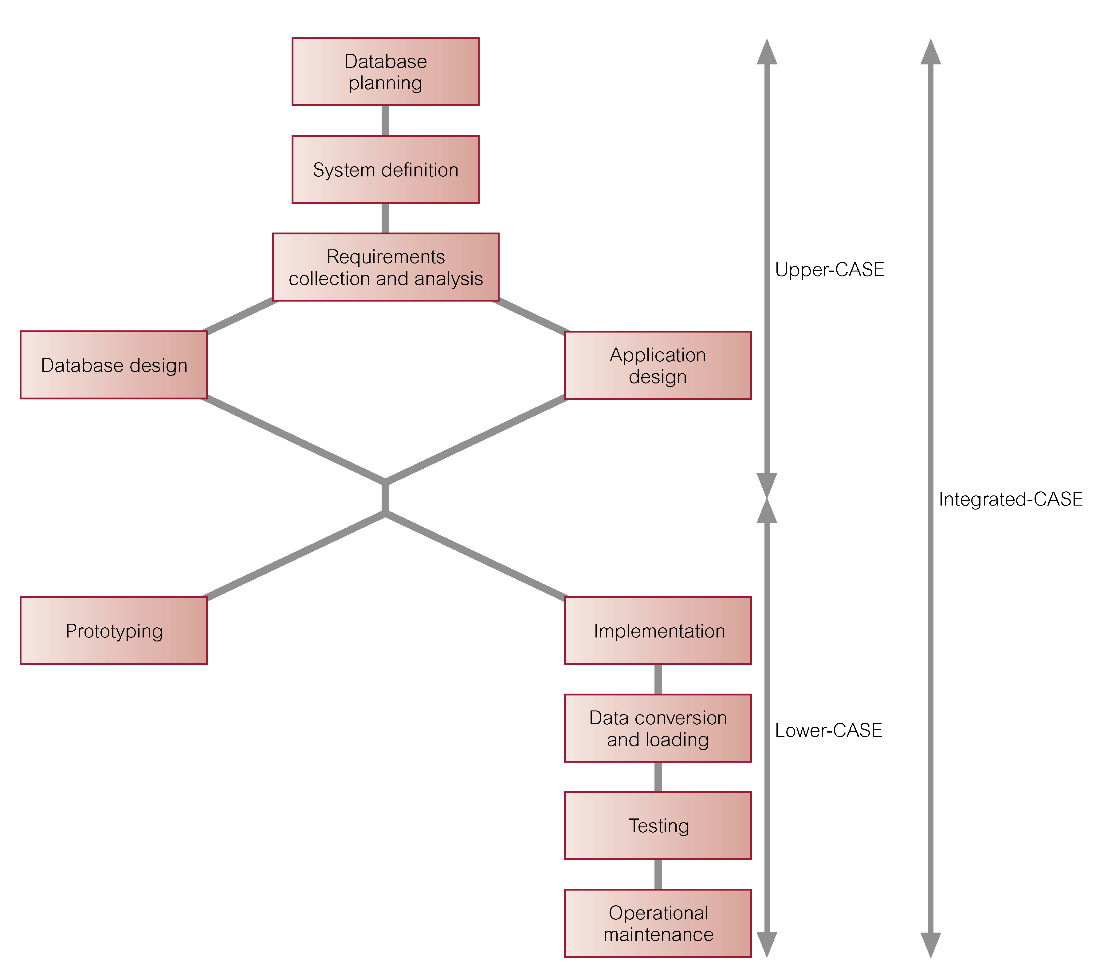
CASE Tools and Database Application Lifecycle

Slide 51
Data Administration and Database Administration
Data Administrator (DA) and Database Administrator (DBA) are responsible for managing and controlling activities associated with corporate data and corporate database, respectively.
DA is more concerned with early stages of lifecycle and DBA is more concerned with later stages.

Slide 52
Data Administration
Management of data resource including:
  database planning,
  development and maintenance of standards, policies and procedures, and conceptual and logical database design.

Slide 53
Database Administration
Management of physical realization of a database application including:
  physical database design and implementation,
  setting security and integrity controls,
  monitoring system performance, and reorganizing the database.

